Slide 1
Overview of the Market for Assisted Rental Housing
Anne Ray
Affordable Housing Workgroup
August 30, 2017

Slide 2
Rental Market Study terms
Low-income: below 60% area median income (AMI)
Cost burdened: paying more than 40% of income for rent
Affordable unit: rent does not exceed 40% of a given income threshold (% AMI), adjusted for unit size
Affordable/available unit: rent is affordable and unit is not rented by a household above the income threshold

Slide 3
Florida has added renters at all income levels since 2000, particularly between 2010 and 2015.
Renter Households by Income (% AMI), Florida, Change from 2000 to 2015
Source: U.S. Census Bureau, 2000 Census and 2005/2010/2015 American Community Survey 1-Year Public Use Microdata Sample (PUMS). Excludes student-headed households.

Slide 4
Florida had a net gain of 869,189 rental units from 2000 to 2015. Only 15% were affordable at or below 60% AMI.
Rental Units by Affordability Level, Florida, Change from 2000 to 2015
Source: U.S. Census Bureau, 2000 Census and 2005/2010/2015 American Community Survey 1-Year Public Use Microdata Sample (PUMS).

Slide 5
Most low-income renters are cost burdened. Few higher income renters are.
Renters Paying More than 40% of Income for Housing by Income (% AMI), 2015, Florida
Source: U.S. Census Bureau, 2015 American Community Survey 1-Year Public Use Microdata Sample (PUMS).

Slide 6
Affordable/Available Units
Compares number of renter households in an income group (0-30% AMI, 0-40% AMI, 0-50% AMI, 0-60% AMI) with supply of rental units
Affordable: with rent at or below AMI rent limit (40% monthly income)
Available: vacant or occupied by income-qualified household (at or below AMI income limit)

Slide 7
Statewide Affordable/Available Units
Affordable/Available Units and Renter Households by Income, Florida, 2014
Source: U.S. Census Bureau, 2014 American Community Survey 5-Year Public Use Microdata Sample (PUMS)

Slide 8
Household Demographics: Size
62% of cost burdened households are 1-2 person
28% are 3-4 person
10% are 5+ person

Slide 9
Household Demographics: Elderly
234,231 cost burdened households (31%) headed by householder age 55+
Includes 37,759 (5%) age 75-84 and 26,561 (4%) age 85+
Highest proportions in southwest coastal regions

Slide 10
Homeless Individuals and Families
Individuals
32,533 homeless individuals
16,458 transitional/permanent supportive housing beds
Families with children
32,304 homeless families with children
4,200 transitional/permanent supportive housing units

Slide 11
Special Needs Household Estimates
Adults with disabilities, receiving SSDI/SSI/VA benefits
107,856 low-income renter households
Survivors of domestic violence
8,295 households using emergency shelter (DCF)
Youth aging out of foster care
3,173 using post-foster care services (DCF)
Total estimate: 119,324 households
16% of statewide total of 756,639 low-income, cost burdened renter households

Slide 12
Farmworkers
Farmworkers
Unaccompanied workers supply gap: 26,640 beds (61,091 unaccompanied workers – 34,451 beds in DOH-licensed camps)
Accompanied workers supply gap: 25,305 units (30,896 accompanied worker households – 5,591 RD/Florida Housing multifamily units)
Highest need counties: Miami-Dade, Hillsborough, Indian River

Slide 13
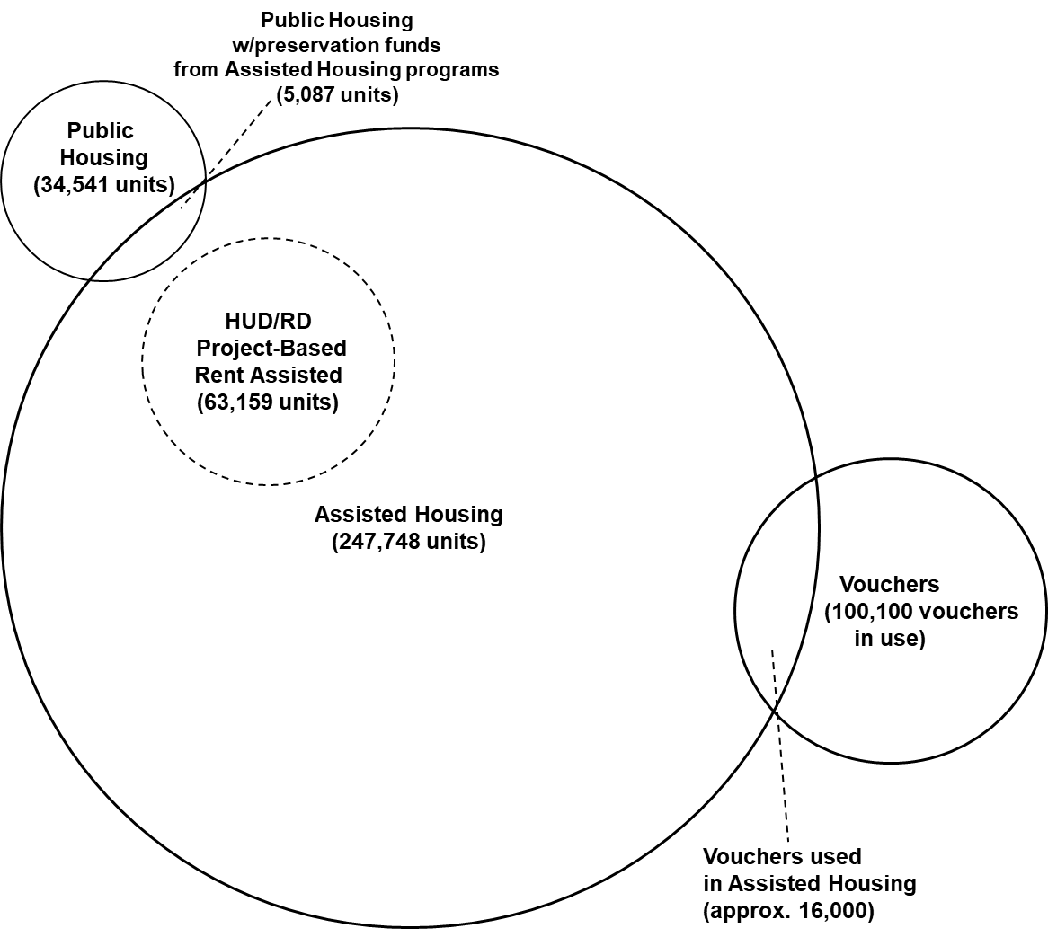
Assisted and Public Housing
Assisted Housing
Privately owned
Subsidized by Florida Housing, HUD, USDA RD, local housing finance authorities
Public Housing
Housing Choice Vouchers

Slide 14
Tenant Characteristics: Income
Average Tenant Household Income, 2016
Source: Shimberg Center for Housing Studies, Assisted Housing Inventory; U.S. Census Bureau, 2015 American Community Survey 1-Year Public Use Microdata Sample (PUMS). “All Florida Renters” numbers refer to 2015.

Slide 15
Tenant Characteristics: Rent
Average Tenant-Paid Gross Rent
Source: Shimberg Center for Housing Studies, Assisted Housing Inventory; U.S. Census Bureau, 2015 American Community Survey 1-Year Public Use Microdata Sample (PUMS). “All Florida Renters” numbers refer to 2015.

Slide 16
Tenant Characteristics: Children & Elderly
Households with Elderly Members (Age 62 and older) and Children (Under Age 18)
Shimberg Center for Housing Studies, Assisted Housing Inventory and U.S. Census Bureau, 2014 American Community Survey 1-Year Public Use Microdata Sample (PUMS)

Slide 17
Expiring subsidies and aging developments pose risks to preservation of assisted housing supply.
Expiring subsidies
LIHTC 30-Year through 2030: 93 developments (15,891 units)
USDA RD Mortgage Maturity (estimated through 2026): 145 developments (7,217 units)
Expiring HUD Rental Assistance through 2026: 157 developments (12,132 units)
Aging developments
30+ years old: 493 developments (39,798 units)
15-29 years old: 867 developments (95,300 units)

